Slide 1
Merge sort
COMP171
Fall 2005

Slide 2
Mergesort
Based on divide-and-conquer strategy
Divide the list into two smaller lists of about equal sizes
Sort each smaller list recursively
Merge the two sorted lists to get one sorted list
How do we divide the list? How much time needed?
How do we merge the two sorted lists? How much time needed?

Slide 3
Dividing
If the input list is a linked list, dividing takes Θ(N) time
  We scan the linked list, stop at the ⎣N/2⎦ th entry and cut the link
If the input list is an array A[0..N-1]: dividing takes O(1) time
  we can represent a sublist by two integers left and right: to divide A[left..Right], we compute center=(left+right)/2 and obtain A[left..Center] and A[center+1..Right]

Slide 4
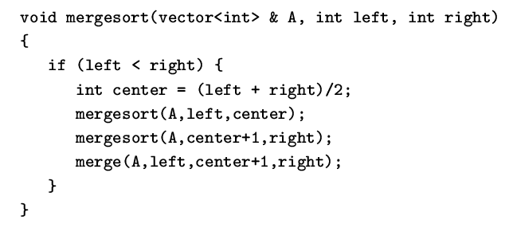
Mergesort
Divide-and-conquer strategy
  recursively mergesort the first half and the second half
  merge the two sorted halves together

Slide 5
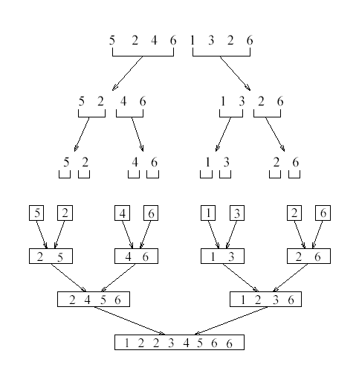
see applet
http://www.cosc.canterbury.ac.nz/people/mukundan/dsal/MSort.html

Slide 6
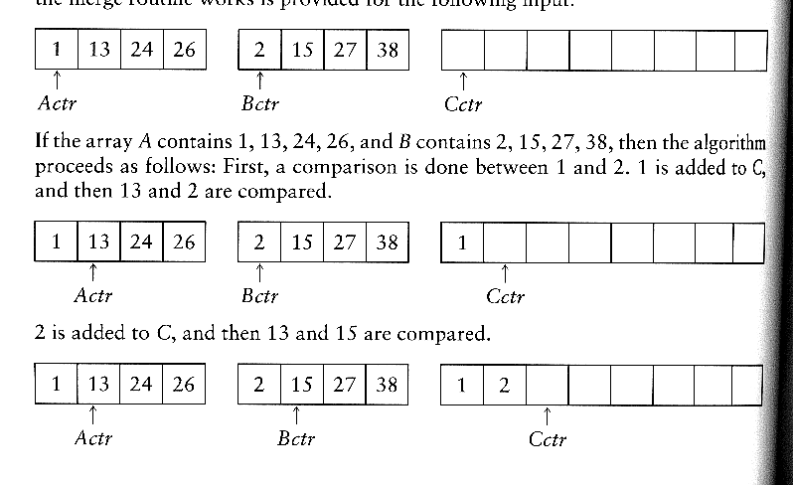
How to merge?
Input: two sorted array A and B
Output: an output sorted array C
Three counters: Actr, Bctr, and Cctr
  initially set to the beginning of their respective arrays
(1) The smaller of A[Actr] and B[Bctr] is copied to the next entry in C, and the appropriate counters are advanced
(2) When either input list is exhausted, the remainder of the other list is copied to C

Slide 7

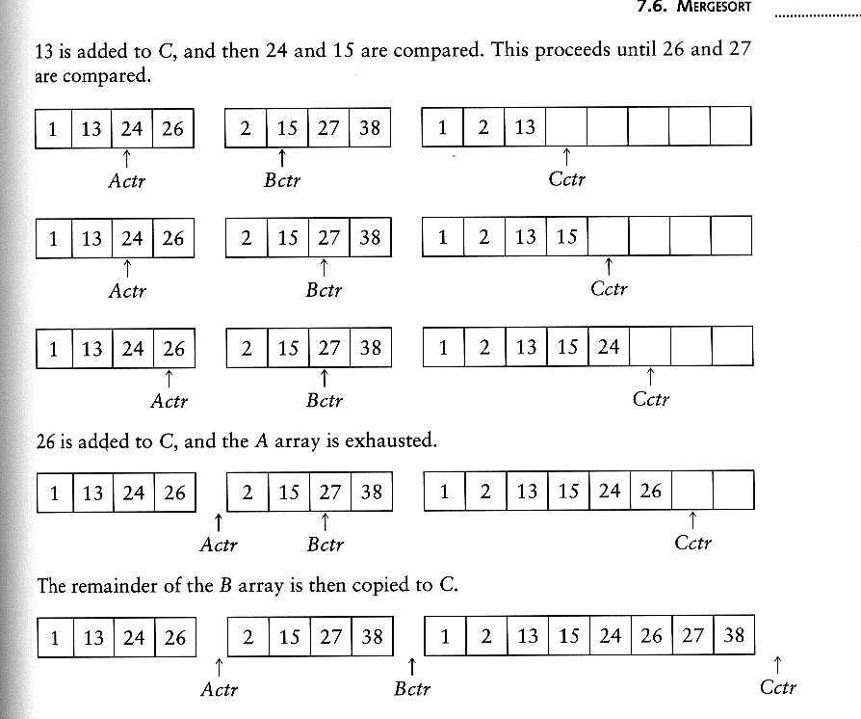
Example: Merge

Slide 8
Example: Merge...
Running time analysis:
  Clearly, merge takes O(m1 + m2) where m1 and m2 are
the sizes of the two sublists.
Space requirement:
  merging two sorted lists requires linear extra memory
  additional work to copy to the temporary array and back

Slide 9
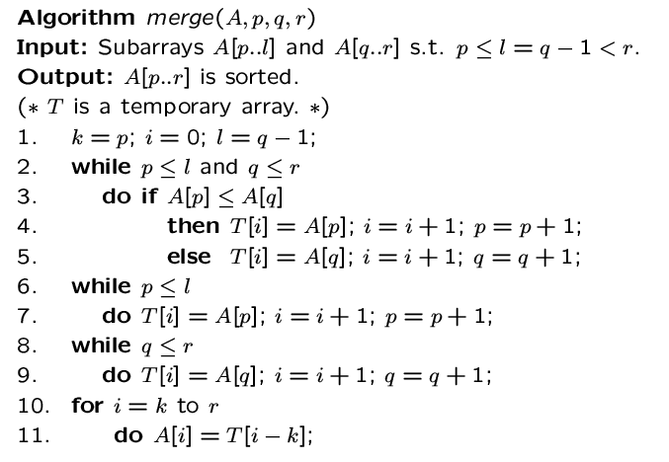

Slide 10
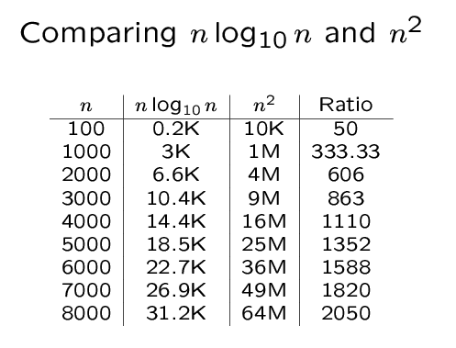

Slide 11
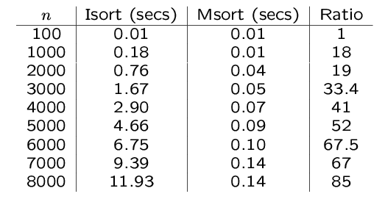
An experiment
Code from textbook (using template)
Unix time utility

